Slide 1

CSE- 321
Software Engineering
Lecture: 07 Software Processes (cont.)
Fahad Ahmed
Lecturer, Dept. of CSE
E-mail: fahadahmed@uap-bd.edu

Slide 2
Lecture Outlines
Agile Model
Big bang model
Prototype Model
Comparison of Various SDLC Models
Software Evolution
Rational Unified Process
Computer-Aided Software Engineering

Slide 3
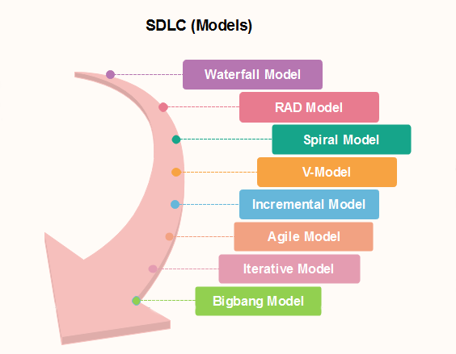
Popular SDLC models

Slide 4
Agile Model
Agile model is a combination of iterative and incremental process models with focus on process adaptability and customer satisfaction by rapid delivery of working software product.
This is where the agile software development comes to the rescue. It was specially designed to curate the needs of the rapidly changing environment by embracing the idea of incremental development and develop the actual final product.
Agile Methods break the product into small incremental builds. These builds are provided in iterations.
Every iteration involves cross functional teams working simultaneously on various areas like planning, requirements analysis, design, coding, unit testing, and acceptance testing.
At the end of the iteration a working product is displayed to the customer and important stakeholders.

Slide 5
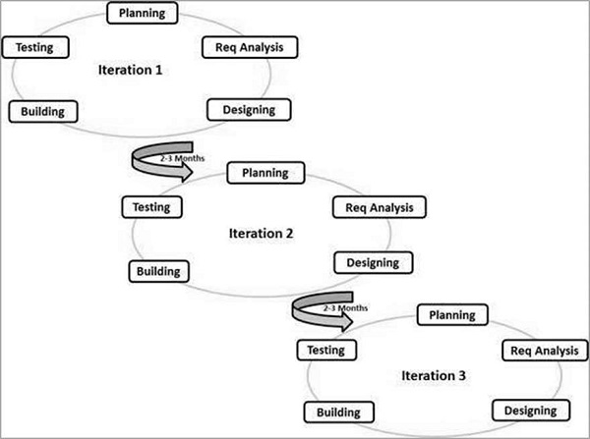
Agile Model
https://www.tutorialspoint.com/sdlc/sdlc_agile_model.htm

Slide 6
Agile Model
Agile model believes that every project needs to be handled differently and the existing methods need to be tailored to best suit the project requirements.
In agile the tasks are divided to time boxes (small time frames) to deliver specific features for a release.
Iterative approach is taken and working software build is delivered after each iteration. Each build is incremental in terms of features; the final build holds all the features required by the customer.

Slide 7
Agile Model
The agile software development emphasizes on four core values.
Individuals and interactions over processes and tools.
Working software over comprehensive documentation.
Customer collaboration over contract negotiation.
Responding to change over following a plan.
https://www.tutorialspoint.com/sdlc/sdlc_agile_model.htm

Slide 8
Agile Model
Principles of Agile model:
Our highest priority is to satisfy the customer through early and continuous delivery of valuable software.
Welcome changing requirements, even late in development. Agile processes harness change for the customer's competitive advantage.
Deliver working software frequently, from a couple of weeks to a couple of months, with a preference to the shorter timescale.
Business people and developers must work together daily throughout the project.
Build projects around motivated individuals. Give them the environment and support they need, and trust them to get the job done.
The most efficient and effective method of conveying information to and within a development team is face–to–face conversation.

Slide 9
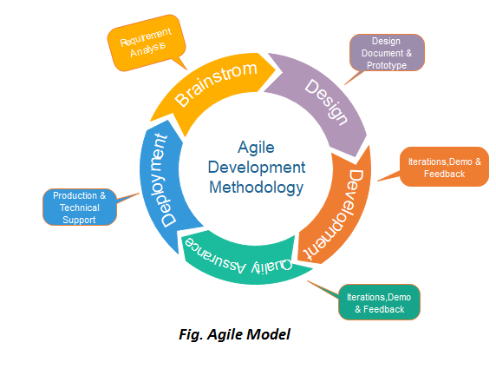
Agile Model
Phases of Agile Model:
Following are the phases in the Agile model are as follows:
Requirements gathering
Design the requirements
Construction/ iteration
Testing/ Quality assurance
Deployment
Feedback

Slide 10
Agile Model
Agile Testing Methods:
Scrum
Crystal
Dynamic Software Development Method(DSDM)
Feature Driven Development(FDD)
eXtreme Programming(XP)
https://www.javatpoint.com/software-engineering-agile-model

Slide 11
eXtreme Programming (XP)
eXtreme Programming (XP):
Extreme programming (XP) is a Software Development Methodology which is intended to improve software quality and responsiveness to changing customer requirements.
XP is a lightweight, efficient, low-risk, flexible, predictable, scientific, and fun way to develop a software.
XP is the most specific of the agile frameworks regarding appropriate engineering practices for software development.

Slide 12
eXtreme Programming (XP)
eXtreme Programming (XP):
Extreme Programming technique is very helpful when there is constantly changing demands or requirements from the customers or when they are not sure about the functionality of the system.
It advocates frequent "releases" of the product in short development cycles, which inherently improves the productivity of the system and also introduces a checkpoint where any customer requirements can be easily implemented. The XP develops software keeping customer in the target.

Slide 13
eXtreme Programming (XP)
Why is it called “eXtreme”?
eXtreme Programming takes the effective principles and practices to extreme levels.
Code reviews are effective as the code is reviewed all the time.
Testing is effective as there is continuous regression and testing.
Design is effective as everybody needs to do refactoring daily.
Integration testing is important as integrate and test several times a day.
Short iterations are effective as the planning game for release planning and iteration planning.

Slide 14
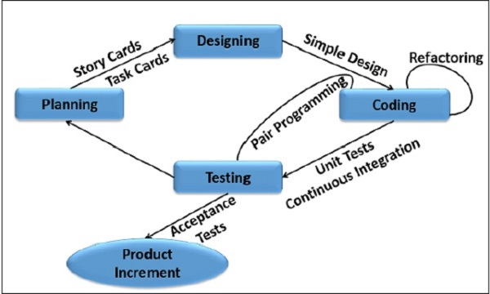
eXtreme Programming (XP)

Slide 15
Agile Model
When to use the Agile Model?
When frequent changes are required.
When a highly qualified and experienced team is available.
When a customer is ready to have a meeting with a software team all the time.
When project size is small.
Advantage :
Frequent Delivery
Face-to-Face Communication with clients.
Efficient design and fulfils the business requirement.
Anytime changes are acceptable.
It reduces total development time.
Disadvantages :
Depends heavily on customer interaction, so if customer is not clear, team can be driven in the wrong direction.
There is a very high individual dependency, since there is minimum documentation generated.
Transfer of technology to new team members may be quite challenging due to lack of documentation.

Slide 16
Difference between Agile and Waterfall Model
Key Difference
Waterfall is a Liner Sequential Life Cycle Model whereas Agile is a continuous iteration of development and testing in the software development process.
Agile methodology is known for its flexibility whereas Waterfall is a structured software development methodology.
Agile follows an incremental approach whereas the Waterfall methodology is a sequential design process.
Agile performs testing concurrently with software development whereas in Waterfall methodology testing comes after the “Build” phase.
Agile allows changes in project development requirement whereas Waterfall has no scope of changing the requirements once the project development starts.

Slide 17
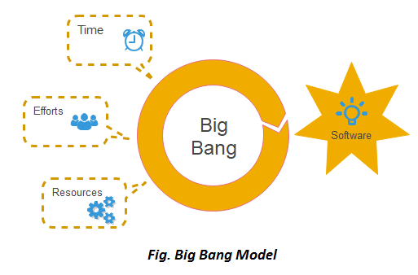
Big Bang Model
When to use Big Bang Model?
This model is required when this project is small like an academic project or a practical project. This method is also used when the size of the developer team is small and when requirements are not defined, and the release date is not confirmed or given by the customer.
Advantages:
There is no planning required.
Simple Model.
Few resources required.
Easy to manage.
Flexible for developers.

Slide 18
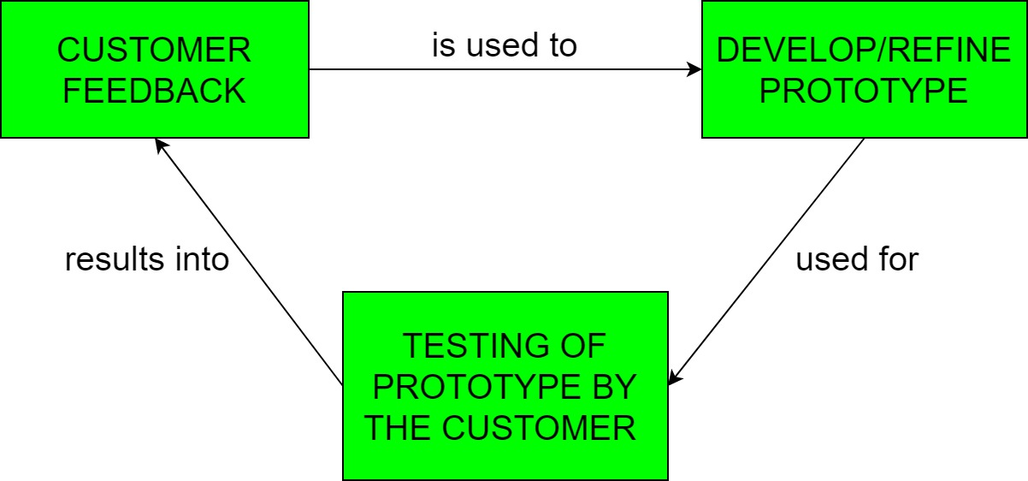
Prototyping Model
In Software Engineering, Prototype methodology is a software development model in which a prototype is built, test and then reworked when needed until an acceptable prototype is achieved.
Regular meetings are essential to keep the project on time and avoid costly delays in prototyping approach.
Missing functionality can be identified
Prototyping may encourage excessive change requests.

Slide 19
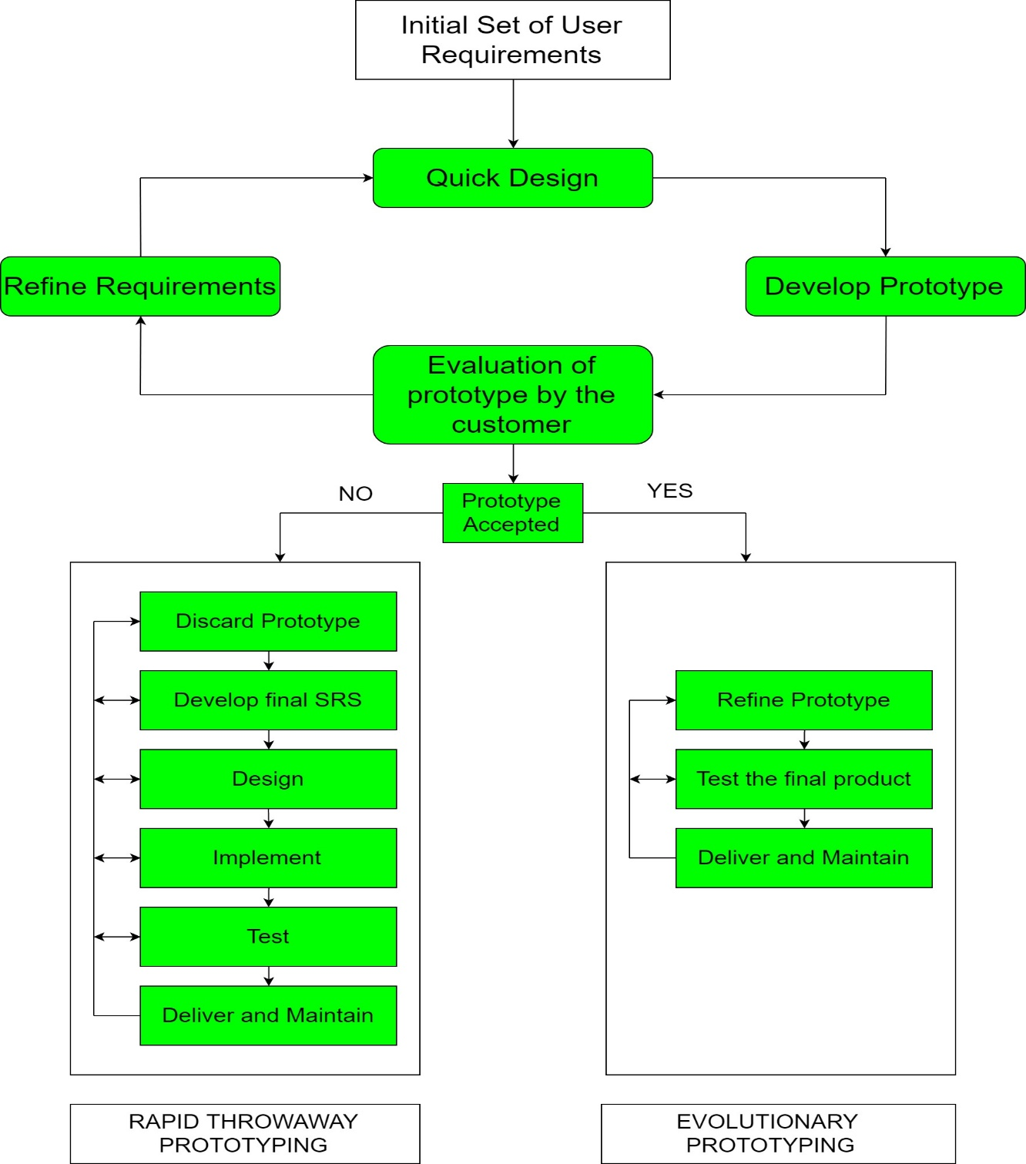
Prototyping Model
There are 2 approaches for this model:
Rapid Throwaway Prototyping
Evolutionary Prototyping

Slide 20
Prototyping Model
When to use
The Prototyping Model should be used when the requirements of the product are not clearly understood or are unstable. It can also be used if requirements are changing quickly. This model can be successfully used for developing user interfaces, high technology software-intensive systems, and systems with complex algorithms and interfaces. It is also a very good choice to demonstrate the technical feasibility of the product.

Slide 21
Prototyping Model
Advantage of Prototype Model
Reduce the risk of incorrect user requirement
Good where requirement are changing/uncommitted
Regular visible process aids management
Support early product marketing
Reduce Maintenance cost.
Errors can be detected much earlier as the system is made side by side.
Disadvantage of Prototype Model
An unstable/badly implemented prototype often becomes the final product.
Require extensive customer collaboration
Difficult to know how long the project will last.
Easy to fall back into the code and fix without proper requirement analysis, design, customer evaluation, and feedback.
Prototyping tools are expensive.
Special tools & techniques are required to build a prototype.
It is a time-consuming process.

Slide 22
Comparison of Various SDLC Models
Properties of Model | Water-Fall Model | Incremental Model | Spiral Model | Rad Model
Planning in early stage | Yes | Yes | Yes | No
Returning to an earlier phase | No | Yes | Yes | Yes
Handle Large-Project | Not Appropriate | Not Appropriate | Appropriate | Not Appropriate
Detailed Documentation | Necessary | Yes but not much | Yes | Limited
Cost | Low | Low | Expensive | Low
Requirement Specifications | Beginning | Beginning | Beginning | Time boxed release
Flexibility to change | Difficult | Easy | Easy | Easy
User Involvement | Only at beginning | Intermediate | High | Only at the beginning
Maintenance | Least | Promotes Maintainability | Typical | Easily Maintained
Testing | After completion of coding phase | After every iteration | At the end of the engineering phase | After completion of coding
Overlapping Phases | No | Yes | No | Yes
Re-usability | Least possible | To some extent | To some extent | Yes
Working software availability | At the end of the life-cycle | At the end of every iteration | At the end of every iteration | At the end of the life cycle
Objective | High Assurance | Rapid Development | High Assurance | Rapid development
Team size | Large Team | Not Large Team | Large Team | Small Team
Customer control over administrator | Very Low | Yes | Yes | Yes

Slide 23
Software Evolution
Software evolution is concerned with modifying existing software systems to meet new requirements. This is becoming the normal approach to software development for small and medium-sized systems.

Slide 24
Rational Unified Process
The Rational Unified Process (RUP) is an example of a modern process model derived from the work on the UML and associated process.
Normally described from 3 perspectives
A dynamic perspective that shows phases over time;
A static perspective that shows process activities;
A practice perspective that suggests good practice.

Slide 25
RUP phases
Inception
Establish the business case for the system.
Elaboration
Develop an understanding of the problem domain and the system architecture.
Construction
System design, programming and testing.
Transition
Deploy the system in its operating environment.

Slide 26
Rational Unified Process
Six fundamental best practices are recommended:
Develop software iteratively
Manage requirements
Use component-based architectures
Visually model software
Verify software quality
Control changes to software

Slide 27
Computer-Aided Software Engineering
Computer-Aided Software Engineering (CASE) is software to support software development and evolution processes.
Activity automation
Graphical editors for system model development;
Data dictionary to manage design entities;
Graphical UI builder for user interface construction;
Debuggers to support program fault finding;
Automated translators to generate new versions of a program.

Slide 28
Computer-Aided Software Engineering
CASE classification
Classification helps us understand the different types of CASE tools and their support for process activities.
Functional perspective
Tools are classified according to their specific function.
Process perspective
Tools are classified according to process activities that are supported.
Integration perspective
Tools are classified according to their organisation into integrated units.

Slide 29
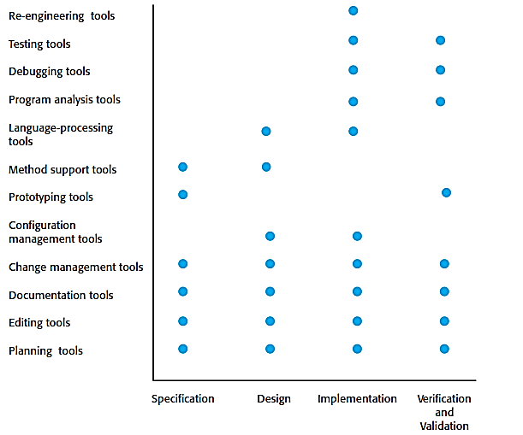
Activity Based Classification of CASE Tools

Slide 30
CASE Integration
Tools
Support individual process tasks such as design consistency checking, text editing, etc.
Workbenches
Support a process phase such as specification or design, Normally include a number of integrated tools.
Environments
Support all or a substantial part of an entire software process. Normally include several integrated workbenches.

Slide 31
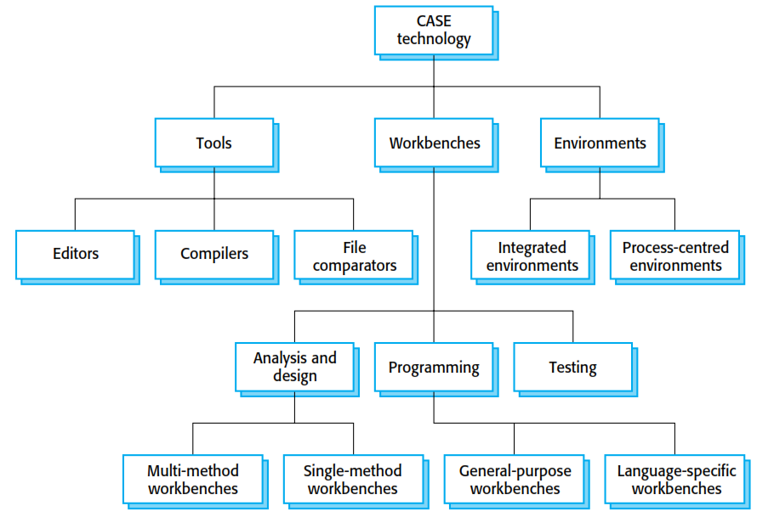
CASE Integration

Slide 32
Ct-01
CT -01 Date: 26-07-2020 class time
L4 to L7---- mcq+ S.Q 10 marks
Only L7 – 10 marks question 10 marks

Slide 33

Thanks to All

